Slide 1
Digital Image Processing
Lecture # 2D: Fundamentals
Imran Siddiqi
imran.siddiqi@mcs.edu.pk
Computer Science Department
College of Telecommunication Engineering
National University of Sciences and Technology
Notes:
Good Morning! My name is Chao.
Today I like to give a topic on “Content-Based Retrieval” which so called “CBR” in multimedia systems.

Slide 2
Contents
Neighborhood & Connectivity
Connected Component Labeling
Distance Metrics
Arithmetic & Logical Operators

Slide 3
Relationships between pixels
Neighbors of pixel are the pixels that are adjacent pixels of an identified pixel
x-1
x
x+1
y-1
y
y+1

Slide 4

4- Neighbors of a Pixel –N₄(p)
x-1
x
x+1
y-1
What are the coordinates of each of the blue pixels
y
y-1
(x-1,y), (x+1,y), (x, y-1), (x, y+1)

Slide 5
Diagonal Neighbors of a Pixel –N_{D}(p)
x-1
x
x+1
y-1
y
y-1
(x-1,y-1), (x+1,y-1), (x-1, y+1), (x+1, y+1)

Slide 6
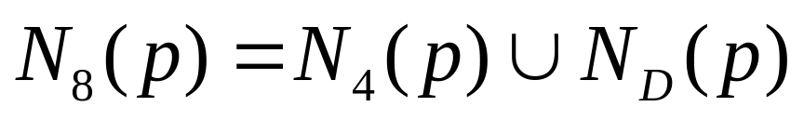
8- Neighbors of a Pixel –N₈(p)
x-1
x
x+1
y-1
y
y-1
(x-1,y), (x+1,y), (x, y-1), (x, y+1)
(x-1,y-1), (x+1,y-1), (x-1, y+1), (x+1, y+1)

Slide 7

Determine different regions in the image

Slide 8
Connectivity
Establishing boundaries of objects and components of regions in an image
Group the same region by assumption that the pixels being the same color or equal intensity
Two pixels p & q are connected if
  They are adjacent in some sense
  If their gray levels satisfy a specified criterion of similarity

Slide 9
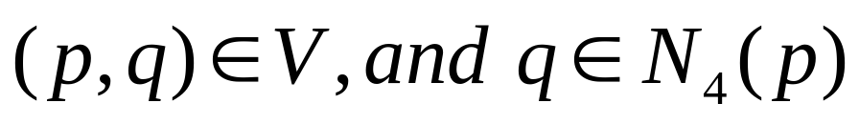
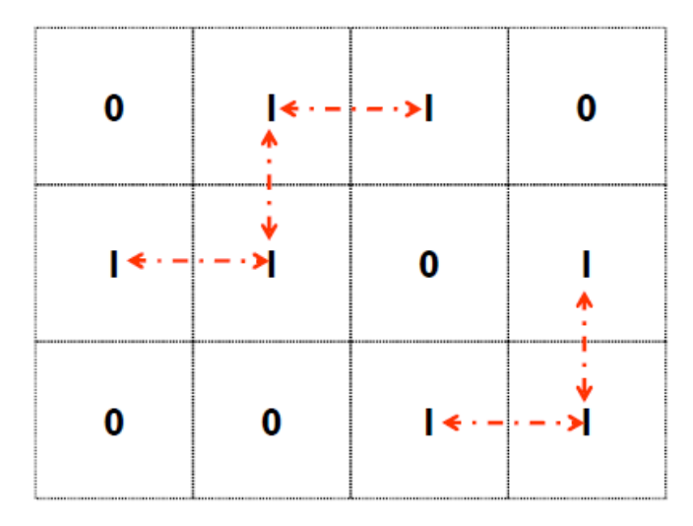
Connectivity
V: Set of gray levels used to define the criterion of similarity
4-connectivity
If gray level
Set of gray levels V = {1}

Slide 10
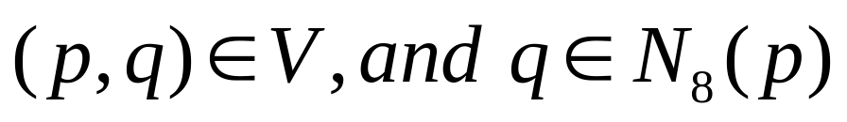
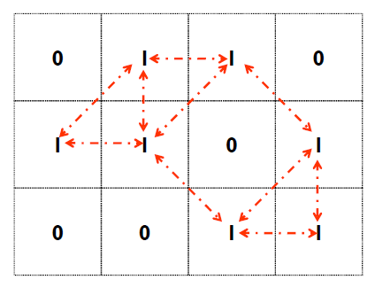
Connectivity
V: Set of gray levels used to define the criterion of similarity
8-connectivity
If gray level
Set of gray levels V = {1}

Slide 11
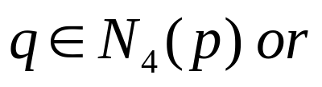
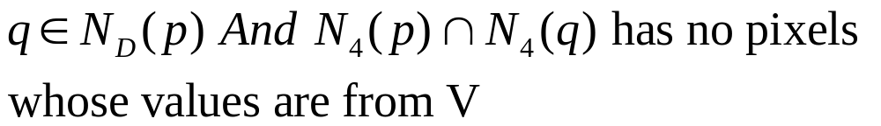
Connectivity
V: Set of gray levels used to define the criterion of similarity
m-connectivity (Mixed Connectivity)
If gray level
a.
b.

Slide 12
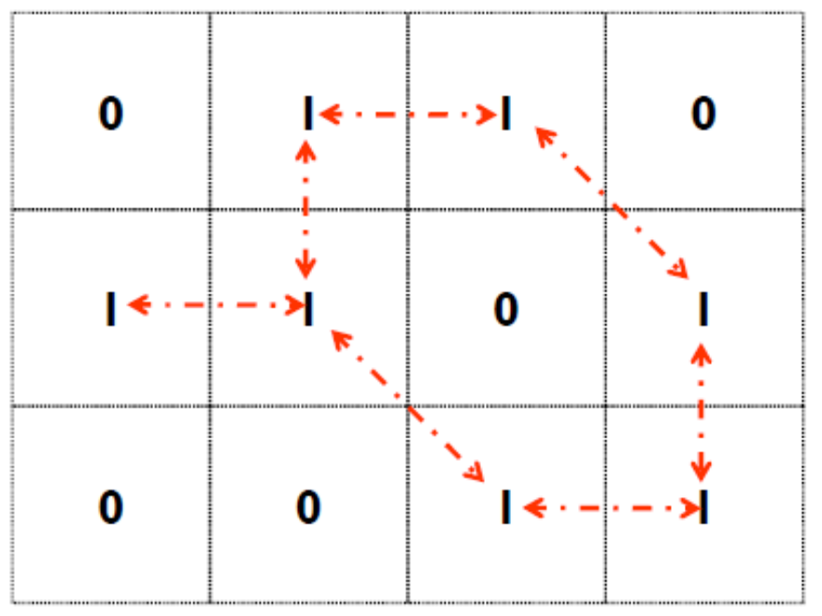
Example: m – Connectivity
Set of gray levels V = {1}
Note: Mixed connectivity can eliminate the multiple path connections that often occurs in 8-connectivity

Slide 13
Paths and Regions
Path: Let coordinates of pixel p: (x, y), and of pixel q: (s, t)
A path from p to q is a sequence of distinct pixels with coordinates: (x₀, y₀), (x₁, y₁), ......, (x_{n},y_{n})
where (x₀, y₀) = (x, y) & (x_{n},y_{n}) = (s, t), and (x_{i},y_{i}) is adjacent to (x_{i-1},y_{i-1}) 1≤i ≤n

Slide 14
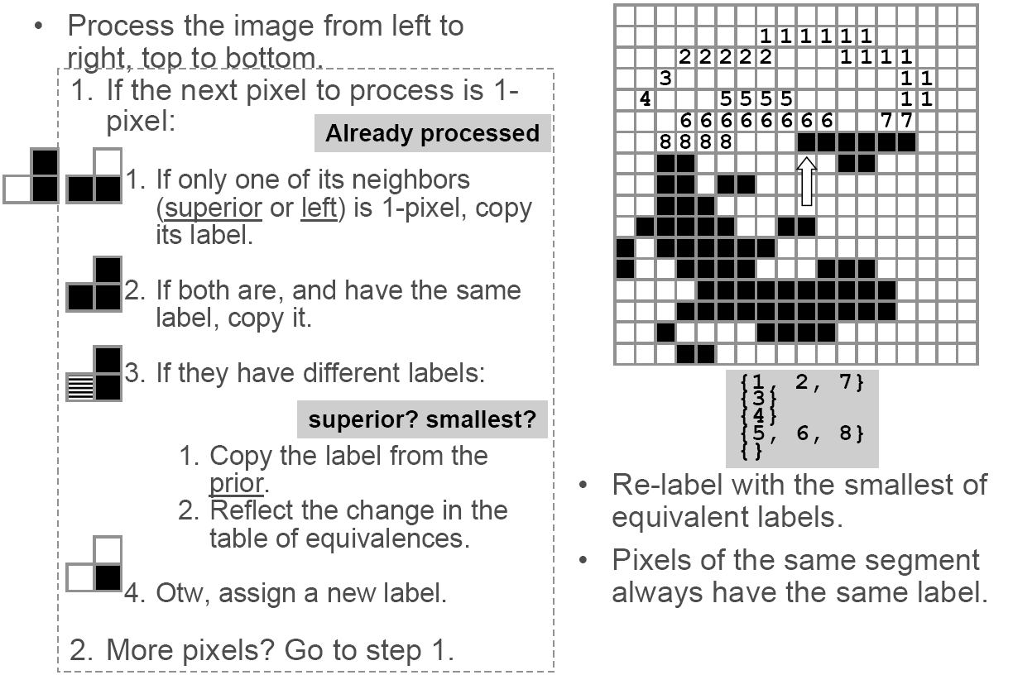
CC labeling – 4 Connectivity
Process the image from left to
right, top to bottom:
  1.) If the next pixel to process is 1
  i.) If only one of its neighbors
  (top or left) is 1, copy its label.
  ii.) If both are 1 and have the
  same label, copy it.
  iii.) If they have different labels
  − Copy the label from the left.
  − Update the equivalence table.
  iv.) Otherwise, assign a new label.
Re-label with the smallest of equivalent
labels
Pass 1
Pass 2

Slide 15

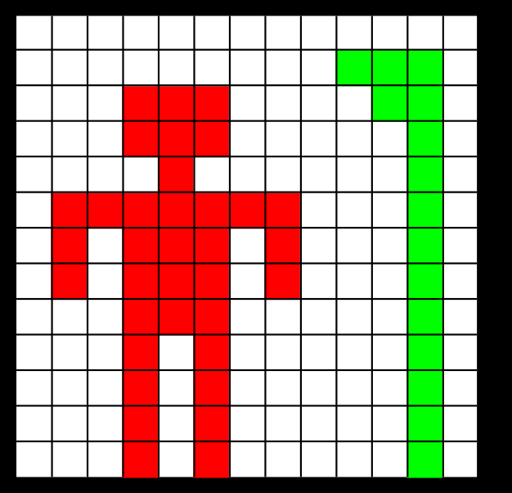
CC labeling – 4 Connectivity

Slide 16


CC labeling – 4 Connectivity

Slide 17
CC labeling – 8 Connectivity
Same algorithm but examine also the upper diagonal neighbors of p

Slide 18
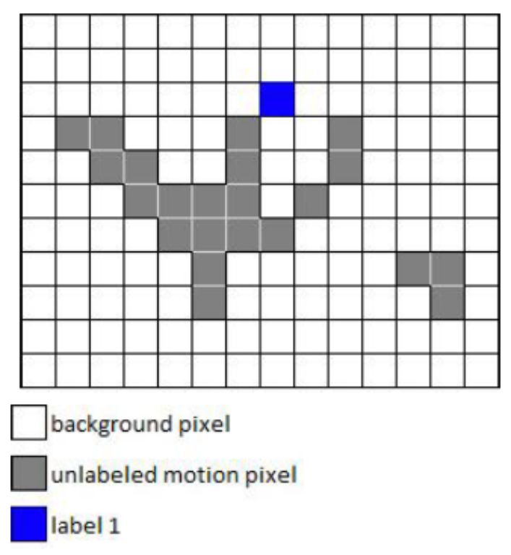
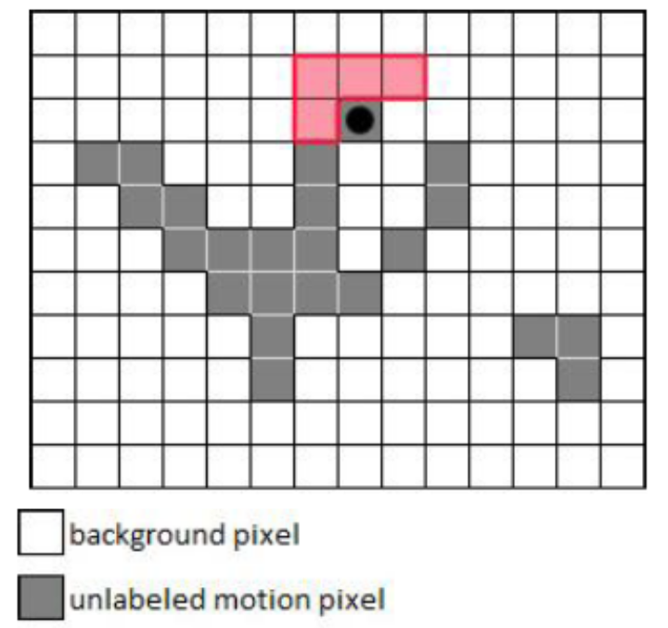
CC labeling – 8 Connectivity
Background pixel
Background pixel
Unlabeled Pixel
Unlabeled Pixel
Label 1

Slide 19
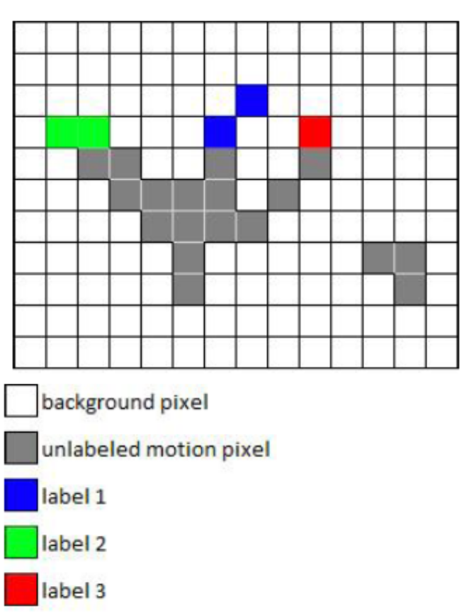
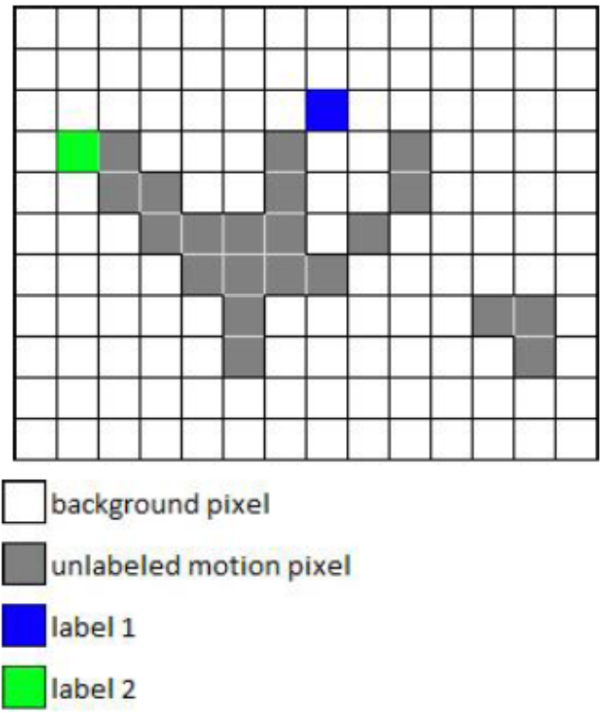
CC labeling – 8 Connectivity
Background pixel
Background pixel
Unlabeled Pixel
Unlabeled Pixel
Label 1
Label 1
Label 2
Label 2
Label 3

Slide 20
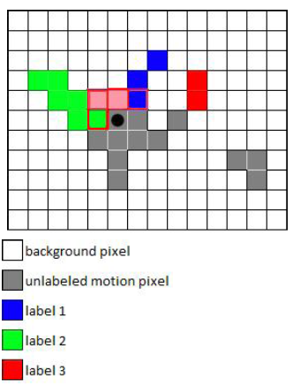
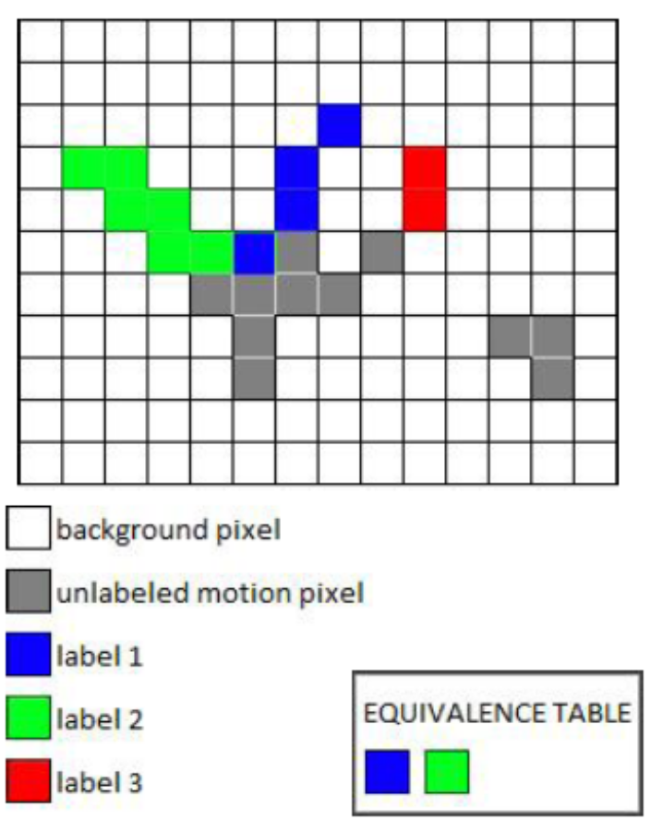
CC labeling – 8 Connectivity
Background pixel
Background pixel
Unlabeled Pixel
Unlabeled Pixel
Label 1
Label 1
Label 2
Label 2
Label 3
Label 3

Slide 21
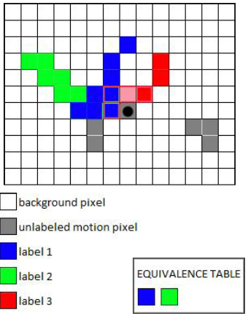
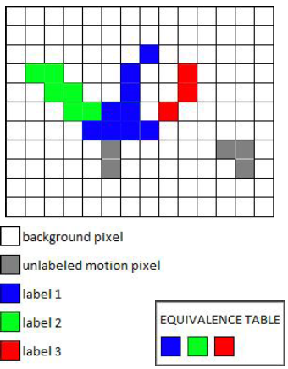
CC labeling – 8 Connectivity
Background pixel
Background pixel
Unlabeled pixel
Unlabeled pixel
Label 1
Label 1
Label 2
Label 2
Label 3
Label 3

Slide 22
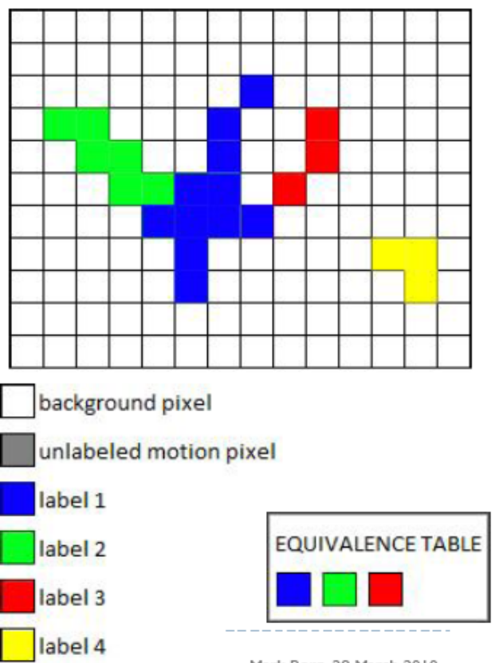
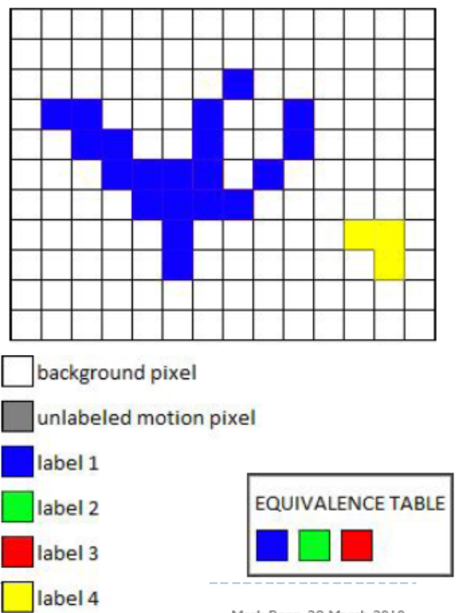
CC labeling – 8 Connectivity
Background pixel
Background pixel
Unlabeled pixel
Unlabeled pixel
Label 1
Label 1
Label 2
Label 2
Label 3
Label 3
Label 4
Label 4

Slide 23
Distance Metrics
Let pixels p, q and z have coordinates (x,y), (s,t) and (u,v) respectively.
D is a distance function or metric if
  D(p,q) ≥ 0 and
  D(p,q) = 0 iff p = q and
  D(p,q) = D(q,p) and
  D(p,z) ≤ D(p,q) + D(q,z)

Slide 24
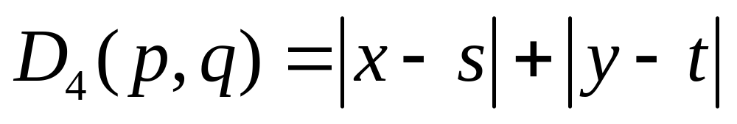
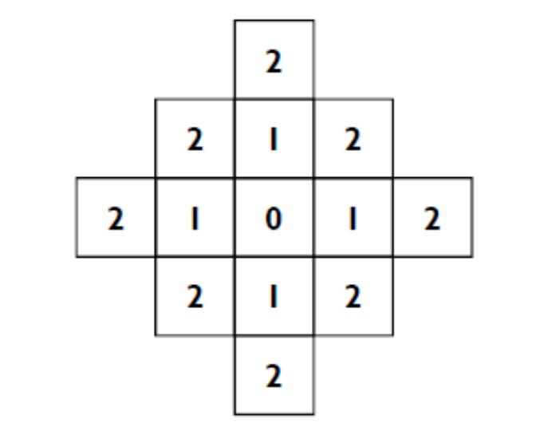
City block distance (D₄ distance)
Diamond with center at (x,y)
D₄ = 1 are the 4 neighbors of pixel p(x,y)

Slide 25
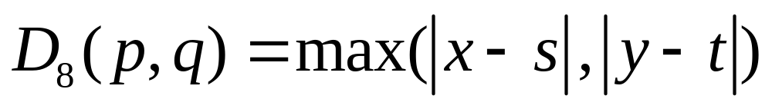
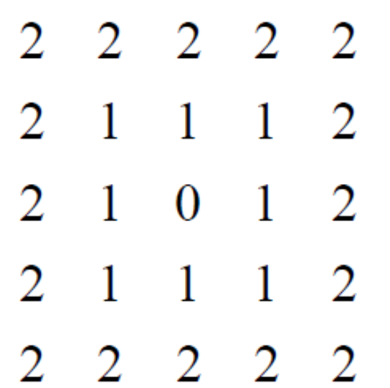
Chessboard distance (D₈ distance)
Square centered at p(x,y)
D₈ = 1 are the 8 neighbors of pixel p(x,y)

Slide 26
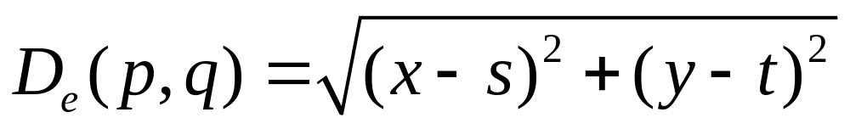
Euclidean Distance
A circle with radius r centered at (x,y)
q(s,t)
r
p(x,y)

Slide 27
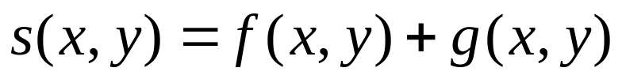
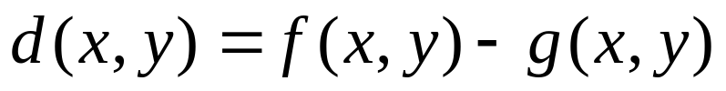
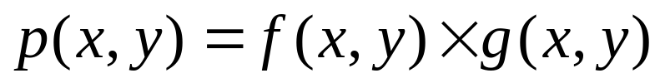
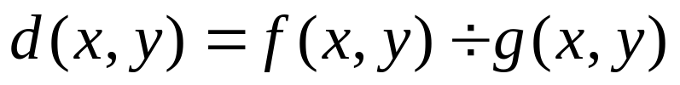
Arithmetic Operations
Carried out between corresponding pixel pairs

Slide 28
Arithmetic Operations
Conversion to range 0 – 255
Difference of two 8-bit images: -255 to 255
Sum of two 8-bit images: 0 to 510
Solution?
Set all values < 0 to 0
Set all values > 255 to 255
Full range of arithmetic operation not captured

Slide 29
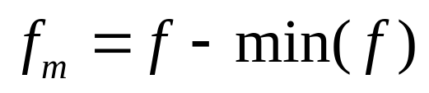
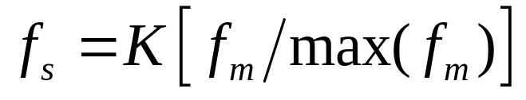
Arithmetic Operations
First perform the operation
Then perform
Creates an image whose minimum value is 0
Creates a scaled image f_{s} with values in the range [0 K]

Slide 30
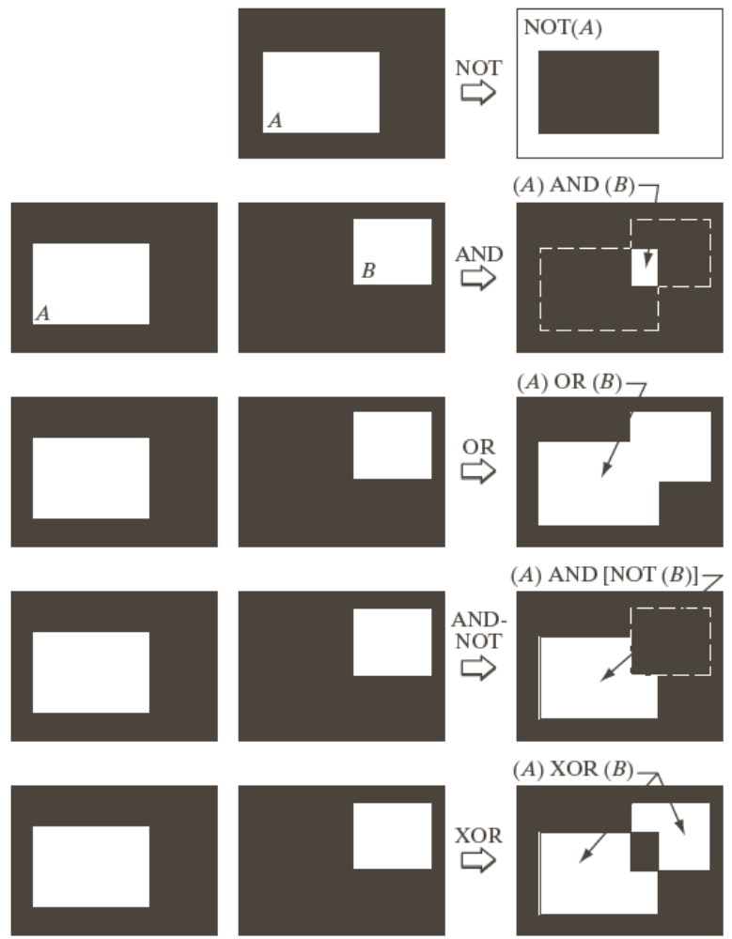
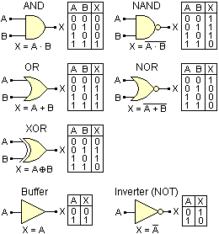
Logical Operations (Binary Images)

Slide 31

Reading Assignment
2.6.1 Array versus Matrix Operations
2.6.2 Linear versus Non-Linear Operations

Slide 32
Readings from Book (3rd Edn.)
2.4 Image Sampling & Quantization*
2.5 Basic Relationships between Pixels
*Discussion related to figures 2.22 and 2.23 has not been covered

Slide 33
Acknowledgements
Digital Image Processing”, Rafael C. Gonzalez & Richard E. Woods, Addison-Wesley, 2002
Peters, Richard Alan, II, Lectures on Image Processing, Vanderbilt University, Nashville, TN, April 2008
Brian Mac Namee, Digitial Image Processing, School of Computing, Dublin Institute of Technology
Computer Vision & Computer Graphics, Mark Borg
Material in these slides has been taken from the following resources

